Slide 1
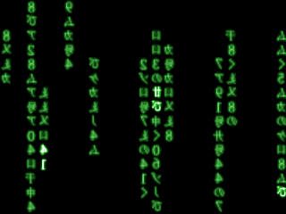
Computer Crime

Slide 2
The Computer Misuse Act (1990) makes the misuse of a computer a criminal offence. The law was introduced in 1990. Throughout the previous decade the growth in the use of computers had made new crimes possible which existing laws did not deal with.

Slide 3
The Act is essentially an anti-hacking law. Hacking is
attempting to gain unauthorised access to a computer system
A hacker is a person who does this. The Act applies to employees of a company who commit these offences from within the company as well as hackers who access computer systems remotely.

Slide 4

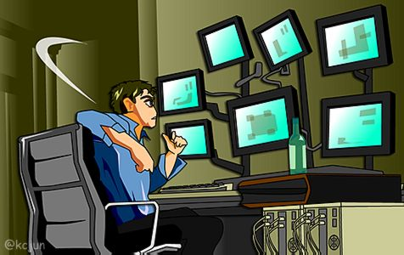
Many hackers attempt to gain unauthorised access to a computer system simply to demonstrate that they are clever enough to do this. Others may have more sinister intentions such as :
Stealing confidential data which might be useful to a rival company.
Changing information stored on a computer system to benefit the hacker.
Destroying data stored in a computer system

Slide 5
The Computer Misuse Act (1990) created three specific offences
1 )Unauthorised access to computer material :
Any attempt to gain unauthorised access to a computer system is illegal. The attempt does not have to be successful. Simply trying to access a computer system that you do not have permission to access is illegal. Under this section of the Act simply trying to "guess" another user's password or trying to load a file that you do not have permission to load would be an offence.
Anyone commiting such an offence can be punished by up to six months in prison and a fine of up to £2000.

Slide 6
The Computer Misuse Act (1990) created three specific offences
2 )Unauthorised access with an intent to commit further offences :
If unauthorised access to a computer system is achieved and this access is used to carry out a further offence e.g. changing the contents of a file to increase your bank balance then the penalties are much stronger.
A prison term of up to five years can be imposed as can a large fine

Slide 7
The Computer Misuse Act (1990) created three specific offences
3) Unauthorised modification of computer material :
This offence covers deliberate erasure or corruption of computer data. It also covers the deliberate introduction of a virus onto a computer system.
A prison term of up to five years can be imposed for committing this offence.

Slide 8

Fraud
Much of the hacking that takes place has nothing to do with a fascination for technology
It is purely theft
Credit card details are stolen by hackers and then used to make fraudulent purchases
Card details may also be stolen by more traditional methods and then used to make purchases on the internet

Slide 9

Fraud on the Internet
Most of the fraud on the internet is caused by lack of control
Anyone can set up a site purporting to be a particular organisation
Goods are offered for sale – but never delivered
Another type of illicit trade involves the sale of software which – once the buyer pays for it – is apparently available for download
  The software will either be garbage or not arrive at all
You need to be aware of the schemes that are available to try and provide some assurance
  Sites that you give credit card details on should have SSL – Secure Socket Layer – the URL will start https
  In the UK, reputable web-sites may have the Which logo on the site.

Slide 10
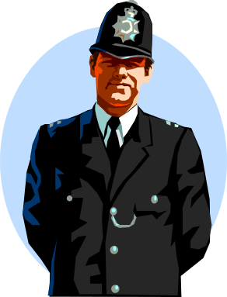

Computers against crime
Computers are now invaluable in the fight against crime
In the 1980s police forces kept information on:
  Cards
  Basic computer systems
If crimes were committed in different force areas if was difficult to create a combined enquiry
  Data was not portable
The case of the Yorkshire Ripper cause a massive enquiry into the way that investigative evidence was handled
The HOLMES system was devised to enable the comparison of information in a more efficient and comprehensive way
All manner of systems now exist in the fight against crime
  One of the latest developments is a system which can capture in ‘real-time’ pictures of people walking in the street and compare them with images held on a database

